Slide 1
Capstone Project
Live Class Monitoring System (Face Emotion Recognition)
Team
Sivaramaguhan S,Vikrmadityasah,Geetha

Slide 2
Content
Introduction
Problem Statement
Data Summary
Approach Overview
Model Overview
Model Evaluation
Real Time Face Emotion Detection
Deployment
Challenges
Conclusion

Slide 3
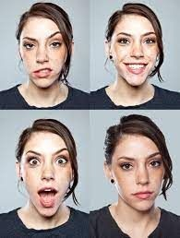
Introduction
Face Emotion Recognition
Importance Applications
Product Development
Video game

Slide 4
Problem Statement
The Indian education landscape has been undergoing rapid changes for the past 10 years owing to the advancement of web-based learning services, speciﬁcally, eLearning platforms.
In a physical classroom during a lecturing teacher can see the faces and assess the emotion of the class and tune their lecture accordingly, whether he is going fast or slow. He can identify students who need special attention. Digital classrooms are conducted via a video telephony software program (ex- Zoom) where it’s not possible for medium-scale class (25-50) teacher to see all students and access the mood. Because of this drawback, students are not focusing on content due to a lack of surveillance. While digital platforms have limitations in terms of physical surveillance but it comes with the power of data and machines which can work for you.This data can be analyzed using deep learning algorithms which not only solves the surveillance issue, but it also removes the human bias from the system.

Slide 5
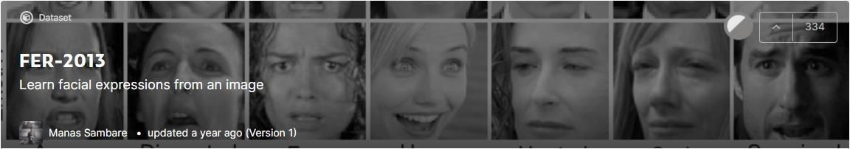
Data Summary
Data Set link
https://www.kaggle.com/msambare/fer2013
This dataset contains 35887 grayscale 48x48 pixel face images with seven emotions.

Slide 6
Data Summary
Label | Emotion | No. of images for Training | No. of images for Testing
0 | Angry | 3995 | 958
1 | Disgust | 436 | 111
2 | Fear | 4097 | 1024
3 | Happy | 7215 | 1774
4 | Sad | 4830 | 1247
5 | Surprised | 3171 | 831
6 | Neutral | 4965 | 1233

Slide 7
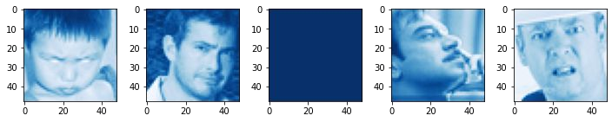
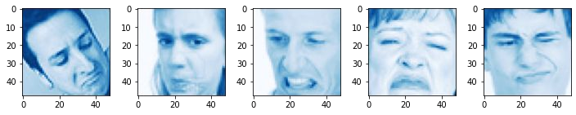
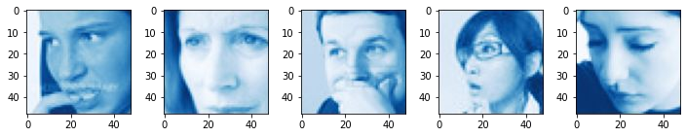
Data Summary
Angry
Disgust
Fear

Slide 8
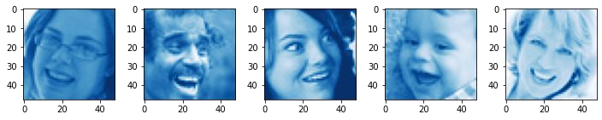
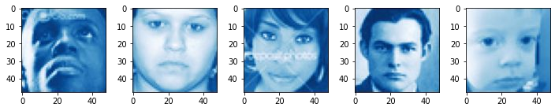
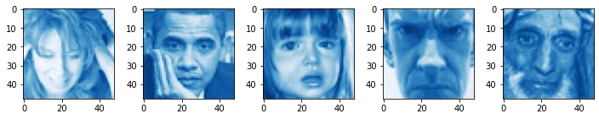
Data Summary
Happy
Sad
Surprised

Slide 9
Pipeline
Model evaluation & deployment
Data Exploration
Modeling
Understanding the data
Modeling structures
Graphs and applications
Types of emotions
Images in each category
Their properties
Transfer learning
CNN
Loss & accuracy plots
Confusion matrix (Heatmap)
Streamlit
Heroku

Slide 10
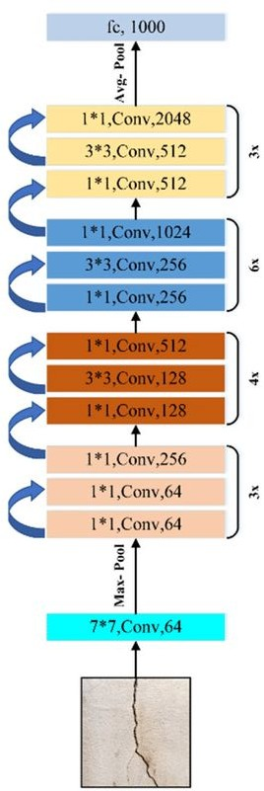
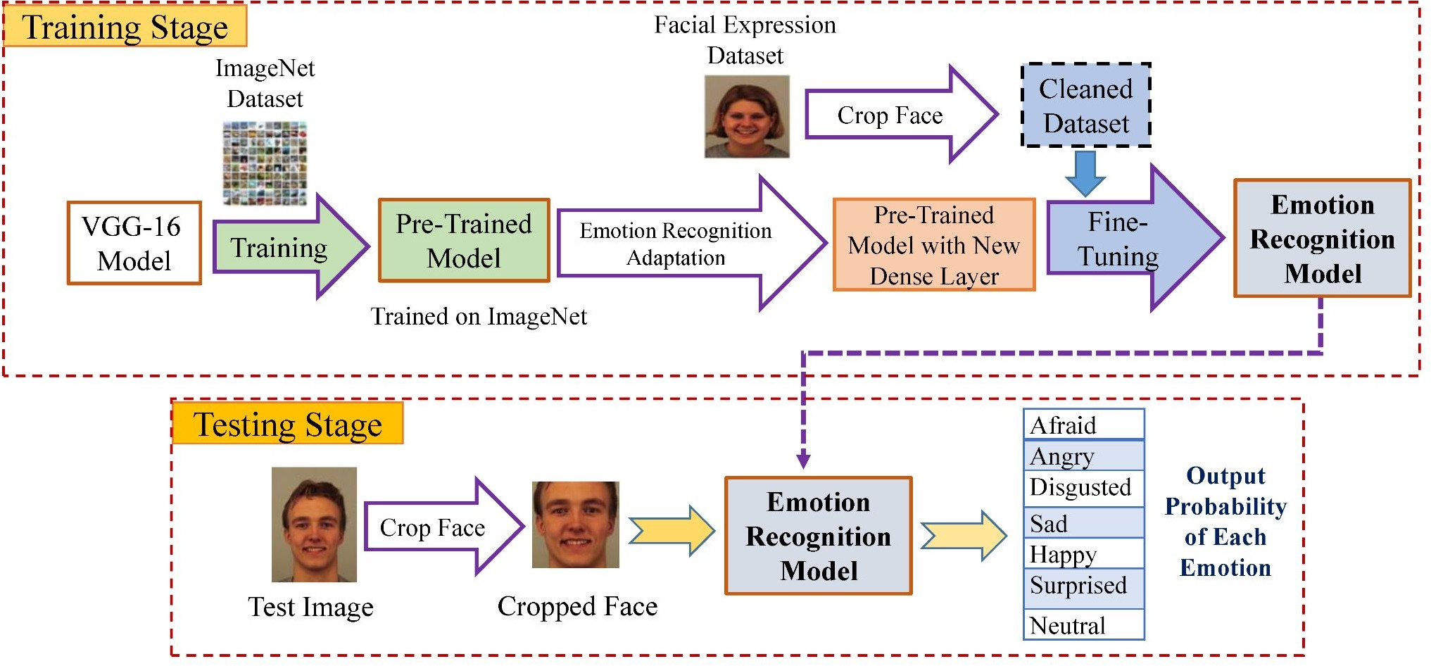
Model Creation
1) Transfer Learning (ResNet50)
ResNet 50

Slide 11
Modeling Steps
Layers
Parameters
Evaluation
Pre trained 50 conv layers
Flatten layer
FCL - 512 units
FCL - 256 units
FCL - 7 units
Activation Function - ReLu, Softmax
Epoch - 50
Optimizer - Adam
Batch size -32
Callbacks- EarlyStopping, ReduceLROnPlateau
Loss and accuracy plots
Heatmap of confusion matrix
Also we use some common techniques for each layer
Batch normalization
Dropout

Slide 12
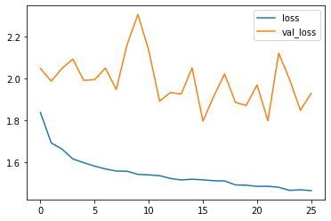
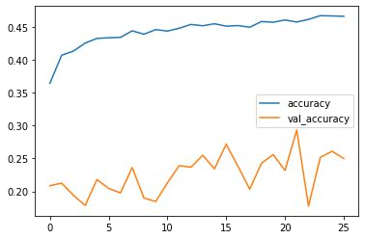
Model Evaluation
Categorical Crossentropy
Accuracy

Slide 13
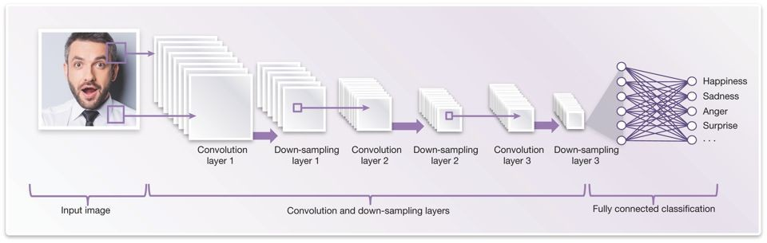
2) CNN

Slide 14
Modeling Steps
Layers
Parameters
Evaluation
Layer 1- 3*3,Conv,64
Layer 2- 3*3,Conv,128
Layer 3- 3*3,Conv,254
Layer 4- 3*3,Conv,512
Flatten layer
FC - 512 units
FC - 256 units
FC - 7 units
Activation Function - ReLu, Softmax
Epoch - 50
Optimizer - Adam
Batch size -32
Callbacks- EarlyStopping, ReduceLROnPlateau
Loss and accuracy plots
Heatmap of confusion matrix
Also we use some common techniques for each layer
Batch normalization
Dropout

Slide 15
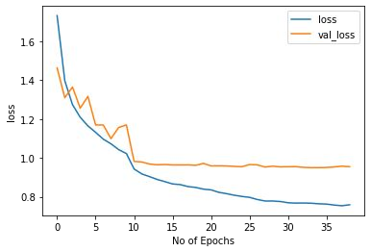
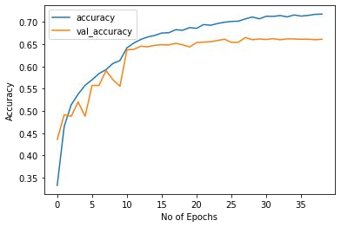
Model Evaluation
Categorical Crossentropy
Accuracy

Slide 16
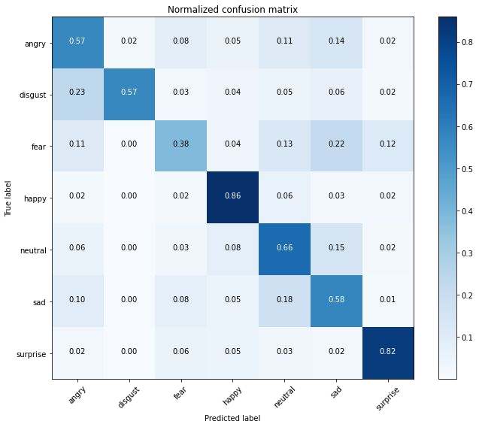
Confusion matrix (Heatmap)

Slide 17
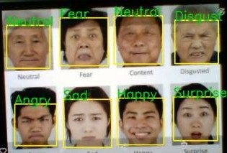
Real Time Face Emotion Detection

Slide 18

Challenges
Large image dataset to handle
Connecting Gpu to jupyter
Selecting No. of ﬁlters and neurons
Selecting batch size to avoid crashing of the system
Deployment

Slide 19

Conclusion
The CNN model gave us training accuracy of 71 % and validation accuracy of 66 %.
A front-end model was successfully created using Streamlit and run on a local webserver.
Successfully deployed Streamlit web app on Heroku and streamlit share that runs on a web server.

Slide 20
Thank You

